Slide 1
India fights COVID-19
Press briefing
22nd May 2020

Slide 2
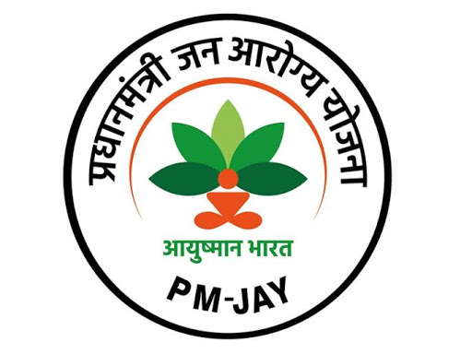
1 Crore treatments provided
‘Sankalp se siddhi’

Slide 3
Lockdown: India’s timely public health measure to fight COVID-19 pandemic
A part of the graded, proactive response to COVID-19 challenge.

Slide 4
Declining COVID-19 Case Growth %
Growth %
New cases
Case growth % = Percentage of new cases over total confirmed cases averaged over 5 days

Slide 5
Declining Growth rate of COVID-19 deaths
% Change

Slide 6
Estimation of COVID-19 Cases and Deaths Averted due to lockdown
Model-based estimates

Slide 7
Methodological Approaches
Modelling studies used widely to help inform decisions about health care and policy
Models based on data drawn from primary and/or secondary sources
Different types of epidemic models
  Stochastic
  Deterministic
  Reproduction number
  (SEIR models )
Each Model has advantages and limitations
The major limitation of complex models are limited data points

Slide 8
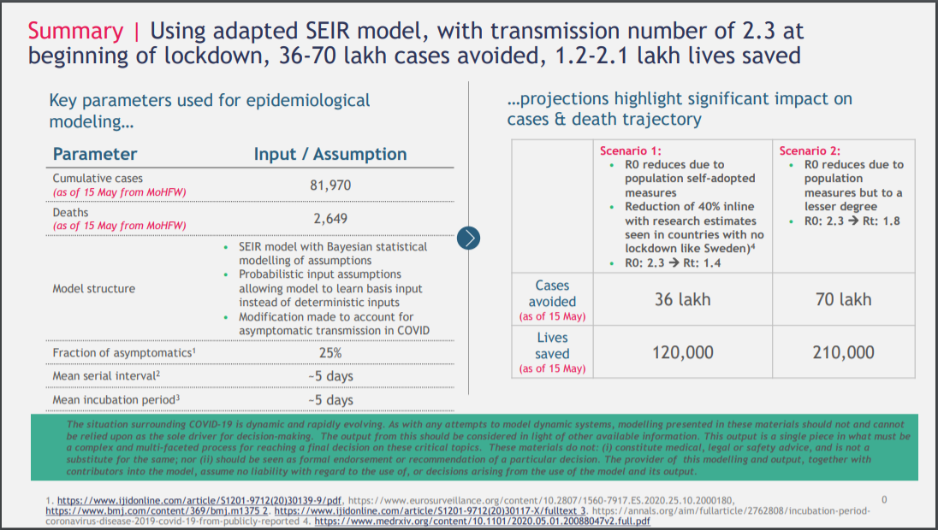
Estimate 1: BCG
Used 2 approaches –Analysis shows 1.2-2.1 lakh lives saved and 36-70 lakh cases averted due to lockdown by May 15
BCG

Slide 9
Estimate 2: PHFI
Remark- As the reported deaths are rising exponentially (until May 15th) therefore, ‘Exponential Growth’ model was considered to estimate average rate of rise in deaths and to extrapolate number of deaths in absence of preventive, containment and mitigation strategies during lockdown, until May 15th.
Nearly 78,000 deaths averted
Pandey S, Reddy KS

Slide 10
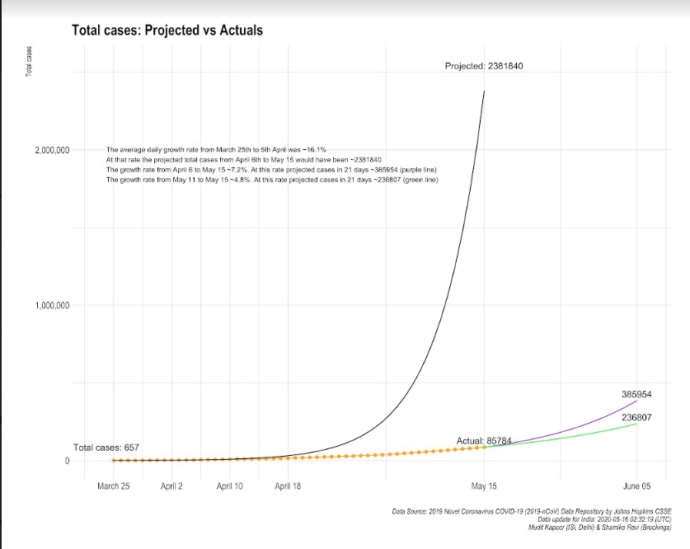
Estimate 3
Cases averted 23 lakh
Deaths averted 68,000
23,81,840
Apprx
Projections vs actual from 25th March, 2020
From 25th March to April 6th – the average daily growth rate was ~16.1%. At that rate we would have had 23,81,840 cases as on May 15th
Actual cases on 15th May - 81,970
Cases averted 22,99,870
15 May
Deaths actual = 2,649. Deaths expected @ 3% = 71,455 apprx. (derived).
Deaths averted = 68,806 apprx. (derived)
Kapoor M, Ravi S

Slide 11
Estimate 4: Independent Experts
 | Number of cases by 15th May if no lockdown was implemented
Cases observed | 81,970
Deaths observed | 2,649
CASES that would have occurred (Estimated using model) | 16,70,942
DEATHS that would have occurred (Estimated using model) | 53,750
Cases averted | 15,88,972
Deaths averted | 51,101
Cases averted 15.9 lakh
Deaths averted 51,000
Apprx
Arvind Pandey, R.M. Mishra, Sandip Mandal & Padum Naryan

Slide 12
Estimate 5: MoSPI/ISI
Cases averted 20 lakh
(Range 14 – 29 lakh)
Deaths averted 54,000
(Range 37,000 – 78,000)
 | Estimated for 15 May | Lower (10%) | Upper (95%)
Cases | 20,82,668 | 14,56,292 | 29,78,459
Deaths | 56,422 | 39,452 | 80,690
Cases averted | 20,00,698
Deaths averted | 53,773
Apprx
MoSPI / ISI

Slide 13
Summary of various estimates:
Cases and deaths averted
 | Cases averted | Deaths averted
Estimate 1 (BCG) | 36-70 lakhs | 1.2-2.1 lakh
Estimate 2 (PHFI) | - | 78,000
Estimate 3 (MK & SR) | 23 lakhs | 68,000
Estimate 4 (AP, RMM, SM, PN) | 15.9 lakh | 51,000
Estimate 5 (MoSPI/ISI) | 20 lakh (Range 14 – 29 lakh) | 54,000 (Range 37,000 – 78,000)
Apprx

Slide 14
Overall Expected Range:
Impact of lockdown (1.0+2.0) on COVID-19 outbreak
Cases averted | 14-29 lakh
Deaths averted | 37,000 – 78,000
This broad range covers the estimates projected by multiple models;
each with respective assumptions.

Slide 15
Life-saving, pandemic control gains of lockdown
A large number of deaths averted
A very large number of cases averted
Much less number of persons spreading infection

Slide 16
Gains of lockdown
Much of the outbreak is confined to limited areas

Slide 17
CURRENT ACTIVE CASES (as of 21st May) are concentrated in a few states and cities/districts
Around 80% in 5 States
    Maharashtra, Tamil Nadu, Gujarat, Delhi and Madhya Pradesh.
Over 90% in 10 States
    Maharashtra, Tamil Nadu, Gujarat, Delhi, Madhya Pradesh, Rajasthan, Uttar Pradesh, West Bengal, Bihar and Karnataka.
Over 60% in 5 Cities
  Mumbai, Delhi, Chennai, Ahmadabad and Thane.
Over 70% in 10 Cities
  Mumbai, Delhi, Chennai, Ahmadabad, Thane, Pune, Indore, Kolkata, Hyderabad and Aurangabad.
Notes:
1) 93.24% of India’s active cases as of 21st May come from 10 States - Maharashtra, Tamil Nadu, Gujarat, Delhi, Madhya Pradesh, Rajasthan, Uttar Pradesh, West Bengal, Bihar and Karnataka.
2) 80.29% of India’s active cases as of 21st May come from 5 States - Maharashtra, Tamil Nadu, Gujarat, Delhi and Madhya Pradesh.
3) 72.48% of India’s active cases as of 21st May come from 10 Cities - Mumbai, Delhi, Chennai, Ahmadabad, Thane, Pune Indore, Kolkata, Hyderabad and Aurangabad.
4) 62.82% of India’s active cases as of 21st May have come from 5 Cities - Mumbai, Delhi, Chennai, Ahmadabad and Thane.

Slide 18
Covid-19 deaths are concentrated in a few states and cities/districts
Over 80% in 5 States Maharashtra, Gujarat, Madhya Pradesh, West Bengal and Delhi.
Around 95% in 10 States
  Maharashtra, Gujarat, Madhya Pradesh, West Bengal, Delhi, Rajasthan, Uttar Pradesh, Tamil Nadu, Andhra Pradesh and Karnataka.
Nearly 60% in 5 Cities Mumbai, Ahmadabad, Pune, Delhi and Kolkata.
Around 70% in 10 Cities Mumbai, Ahmadabad, Pune, Delhi, Kolkata, Indore, Thane, Jaipur, Chennai and Surat.
Notes:
1) 95.84% of India's total deaths have come from 10 States - Maharashtra, Gujarat, Madhya Pradesh, West Bengal, Delhi, Rajasthan, Uttar Pradesh, Tamil Nadu, Andhra Pradesh and Karnataka.
2) 82.56% of India's total deaths have come from 5 States - Maharashtra, Gujarat, Madhya Pradesh, West Bengal and Delhi.
3) 70.18% of India's total deaths have come from 10 Cities - Mumbai, Ahmadabad, Pune, Delhi, Kolkata, Indore, Thane, Jaipur, Chennai and Surat.
4) 58.97% of India's total deaths have come from 5 Cities - Mumbai, Ahmadabad, Pune, Delhi and Kolkata.

Slide 19
Gains of lockdown: preparedness
Huge COVID-19 specific health infrastructure
Capacity development of HRH
Increased testing capacity
Massive increase in supplies, equipment, oxygen
Guidelines, standards prepared, circulated, adopted, practiced
R&D response: diagnostics, virus studies, drug trials, sero-epidemiology, vaccine research, tech

Slide 20
Tele / digital push
‘Aarogya setu’
Accelerated adoption of telemedicine
E- Sanjeevani

Slide 21
Gains
Healthcare and frontline workers gained experience and confidence
Clinical management experience gained
Low mortality sustained
Wait for potential drugs, treatments and vaccine shortened
Surveillance strengthened

Slide 22
States are prepared
  Districts are prepared
    Municipalities prepared
      Panchayats are prepared

Slide 23
A people’s movement to fight the pandemic has built up
Awareness
Behaviour change
Jan Andolan
‘Sankalp se siddhi ki ore…’

Slide 24
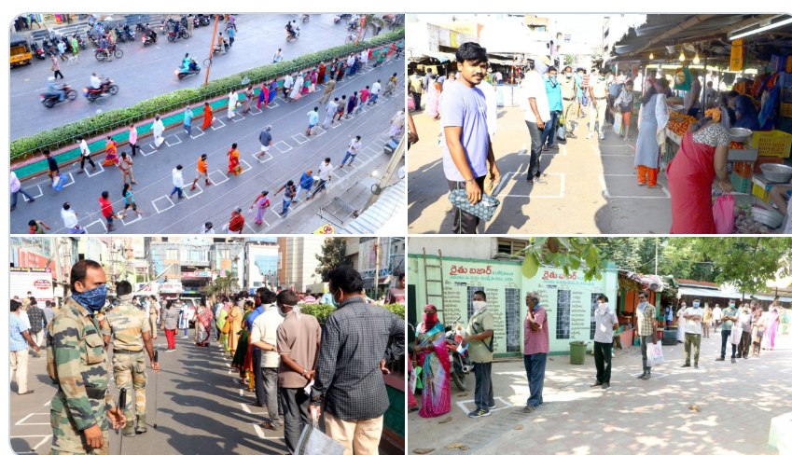
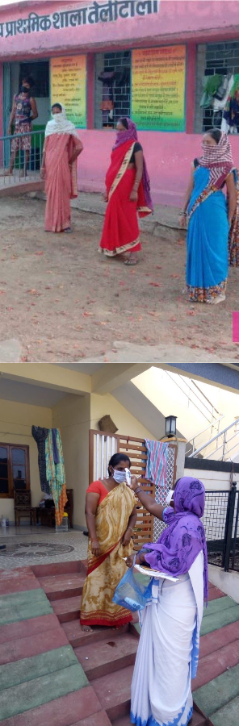
Thank you
Corona haarega, desh jeetega.

Slide 25
MoSPI Model - Log-Linear Function
( Simple and give robust results)
Log-Linear model used (assuming exponential growth), that is log Y_{t} = a + bX_{t}
Death Rate: 3% of cases (applied to cases)
Doubling Time: 4.32days
Time period for modeling: 13/03/2020 to 07/04/2020
Advantages
  Caters to the expected exponential growth in COVID-19 cases.
  Provides provide comparatively better estimates keeping in view the limited data points
Limitations
  Normality assumption is not tested
  Projections need to be revised in long run

